Slide 1

COVID-19 Health Crisis:
Getting Through This Together,
School Social Work in a Changing Landscape
Michael Kelly Ph.D, LICSW
Christy McCoy MSW, LICSW
Stephanie Ochocki DSW LICSW
Kari Smith Ph.D
Steve Whitmore MSW LMSW

Slide 2
Introduction
Impact of COVID-19 on us as mental health professionals
Ethical responsibilities in meeting the needs of students during this health crisis
Guidance related to mental health service delivery
Strategies for talking with families
Resources to support your practice
Notes:
Christy will take the lead providing the introduction & cueing for transitions when needed.
Mike & Steve-15 minutes

Slide 3
Impact of COVID-19 on us as Mental Health Professionals
How are we processing the current health crisis as mental health practitioners/professionals and as individuals?
Check-in with ourselves - Acknowledge role of stress, anxiety and fears on thoughts
What is in our control?
What is out of our control?
Shifting identity and embracing new service delivery strategies
Social distancing does not equal emotional distancing
Balancing staying informed with being intentional of our own needs for self-care https://www.tenpercent.com/coronavirussanityguide
Notes:
Notice are your thoughts helpful right now or are they future oriented. Similar to our students and families we are faced with the task of trying to navigate not only our own worries and concerns but with the changing reality of how to best support the needs of our students. What we have become accustomed to in how we practice is suddenly changing and forcing us to step out of our comfort zone to adapt to a new normal. Whether you are at the beginning, middle or nearing the end of your career, finding ways to manage the disruption of how we live our lives and practice social work in the midst of this health crisis invariably is impacting us physically, emotionally and spiritually.
How can we alter how we practice to meet the emotional and social needs of the students with whom we are working? HIPAA requirements and use of virtual platforms when meeting with students. Recognize that first and foremost our student are also experiencing a new layer of anxiety which can trigger increased fears connected to past trauma. Researching and/or creating lessons that can be completed online Talking about Corona Virus with Kids, using social stories; SEL activities, trauma informed strategies.
Identifying systems of support for us is vital. This webinar is one example of how being connected to your national association can provide you with one avenue for obtaining resources and support not only in managing this new normal. Peer to Peer Support; State SSW Association and SSWAA will continue to provide practice resources to access through website, conferences, discount on books, position papers, etc.
Keeping a realistic perspective of the situation based on facts is important.

Slide 4
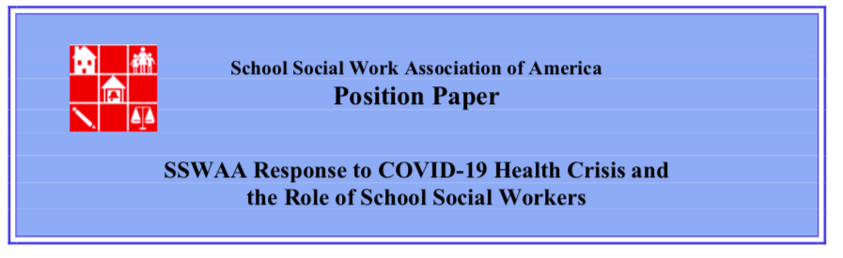
Ethical Considerations
Stay safe and practice good healthy habits and self-care.
Identify what your state and school district’s policies are regarding SSW services as this crisis unfolds--U.S. school policy is largely driven by state and local regulations, and this is an opportunity for you to advocate and lead.
Clarify how SSW services will be done in the event that you’re providing them online and what the issues related to HIPAA, FERPA, and IDEA compliance are (and once you know what’s expected, assess how that fits with our COE)
Anticipate that this will be a long process of getting “back to normal” and may in fact require us all to become more trauma-informed in our SSW practices as schools eventually re-open.
Notes:
Introducing Steven Whitmore, Oakland (MI) School Social Work Consultant

Slide 5
Education Systems are Very Complex
GOVERNOR DIRECTIVES
FUND I NG
CDC/ WHO/ PRESIDENT
UNCLEAR EXPECTATIONS
ADMINISTRATIVE WELLNESS
UNIONS
IDEA/504
School District
HIPAA
TECHNOLOGY
ADVOCATES
FERPA
SES STATUS
GENERAL ED VS SPECIAL
PARENTS
FOOD/HOUSING ISSUES
STATE LAW
SCHOOL BOARDS
NEIGHBORING DISTRICTS
HEALTH CODES
TEACHER WELLNESS
Status of Cases in the State
Notes:
As mental health professionals, we want to make sure our kids are safe and that their needs are being met. We also want to make things happen quickly so that we can bring a sense of safety.
It is important to keep in mind, Schools are very complex systems. In this slide, we show some of the influences that can typically have an impact on a school system. It takes schools months and years of planning in order to implement changes in their systems. In making decisions, there are many considerations.
This disease and mandates from state and federal levels have taken those system processes and has forced districts to make choices and to make unprecedented decisions in less than one or two days’ time.
The landscape right now is “as clear as mud”. Expectations are very vague and conflicting. Different team members’ interpretations of a directive might lead each down a different path. Districts might be ready to move into one direction, but then some policy, law or entity reminds them of why they can’t move into that direction.
Should we also add onto this that everyday, the landscape is changing. Things are becoming more restrictive, but not necessarily more definitive in terms of what we should plan for short or long term.

Slide 6
Continuum of Responses
Some Supportive Services
“Enrichment”
Full Legal Services in a Virtual Platform
“Best that we can”
No/Few Services
“Extended Spring Break”
Examples of School Social Work Practices
Not reporting for work
Unsure of what to do
Making sure resources are posted to website
Responding to emails / on call
Awaiting direction
Weekly emails on information/resources coping skills or activities
Weekly phone calls to at-risk students/families
Enrichment activities/Supplement Packets
Finding food/housing, childcare etc.
Mindfulness/wellness activities to teachers
Conducting IEP Meetings
Remote lessons
Modules
Working on accommodating lessons with teachers
IEP Meetings
Virtual Meetings
Packets of information
Notes:
So how are districts responding? There are basically a continuum of responses from districts. At one end, we have this is an Extended Spring Break or a long series of snow days. People aren’t reporting for work, they might have a few newsletters sent home or something on the school website about stress. Or they might be responding to emails or emergencies. But overall, the position is this should be over in a few weeks and we’ll figure things out closer to then.
On the other end, you have some districts thinking like acting like we need to be a typical school system in a virtual world. You can see them trying to figure out how to implement some everyday instruction and services in a very short time. I have heard some discussion go about this in my area. In fact, several districts closed their doors prior to the official school shut down to conduct some teacher training on virtual learning. Some social workers in these districts have been exploring virtual platforms like Zoom or WebEx. But unless the school was a virtual academy to begin with, I haven’t really heard of successful implementation yet.
Then, in the middle, we have districts not necessarily calling what they are doing “instruction” or more accurately “instruction for credit.” Teachers might be sending home some packets similar to those that we might see during the summer. But they don’t come with a grade. Social workers might have done some posting in their Google classrooms, or sent home some activities, but it is not typical your typical service delivery. Wellness phone calls to parents might be happening. A few are preparing to hold some IEP Meetings virtually, but their staff aren’t necessarily “reporting” everyday.
So right now, we are truly building the plane as we are we are flying it. Every day, we get more information. And as time passes, things might become clearer. What is important right now is keeping in touch with your administrators and monitoring the situations with your students, their families and your schools, and lending your voice to the conversation and rolling up your sleeves as needed.

Slide 7
Delivery of SSW Services - Special Education
Considerations
Guidance from US Department of Education
Guidance from OCR
Guidance from State Department of Education
Guidance from your District Leadership
Guidance from your District Attorneys
Questions:
How are the days your school is closed being defined and what does that mean in your State?
What is being provided to students without disabilities?
What technology does the District have available for staff to provide services?
How can you connect with other school social workers to share and develop resources?
Notes:
Smith
Questions:
Difference between Act of God days and emergency days. Look to your State for guidance
Students with disabilities must have the same opportunities as students without disabilities
Can staff provide e-learning opportunities? Is it possible for students to engage this way?
-In times like this, it is important to lean on your school social worker friends to share resources and ideas.

Slide 8
Additional Considerations
Considerations for Vulnerable Populations:
Guidance for students who are identified as McKinney-Vento
Social-emotional & mental health support and crisis situations for students
Families without access to the internet or phone
Students/Families who are linguistically diverse (i.e., English Learners)
Other Considerations:
Supporting colleagues
Self-care
Notes:
Smith
Food delivery/pick-up options
Families without transportation
Families who are mobile, i.e., staying in a shelter
Social-emotional & mental health support
How are you supporting in crisis situations?
Have you sent out a list of local mental health agencies to families?
How are local mental health agencies changing their practices due to COVID-19?
Families without access
Share free internet resources
Other ways that students can learn/participate
Consider other ways staff can check-in with students
Linguistically diverse
Are materials being translated?
How can students who are linguistically diverse be engaged during school closures?
Other considerations?
Consider virtual check-ins with your colleagues-maybe at the end of the week
How are you taking care of yourself as you take care of others?

Slide 9
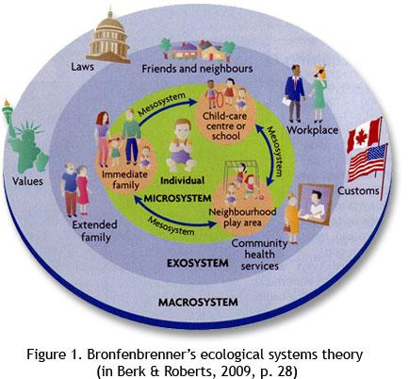
How to Talk with Families
References to reputable resources
World Health Organization (WHO)
Centers for Disease Control & Prevention (CDC)
Personal physician
Local authorities
Your school district, your municipality, your state
Stressors as a caregiver
Health & wellbeing
Resource barriers
Workplace
Notes:
Christy, make sure I’m done speaking to this slide before advancing. The video on the next slide is set to automatically play when Google Slides is in Present mode.
Stephanie
Anchoring ourselves & our parents/caregivers in with reputable resources for information & support during the COVID-19 pandemic is essential.
Information continues to change & it is important for everyone to think about what sources they need to look to as it impacts their home life and work life.
SSWs need to establish rapport with parents and caregivers in the context a changed environment.
-Consider this depiction of Bronfenbrenner’s ecological model and think about the ways the COVID-19 pandemic is specifically altering our environments, how we operate and interact.
-Parents and caregivers will be experiencing increased levels of distress.
-They have always been primarily responsible for the health and wellbeing of their children. Yet famous quotes like, “A parent is a child’s first teacher!” and “Home is a child’s first and most important classroom!” take on a whole new meaning when restrictions to promote social distancing result in activities cancellations & school closures.
-As we’ve heard earlier, from Dr. Smith, barriers to resources can have an inequitable impact on vulnerable populations. Parents and caregivers experiencing employment disruptions due to COVID-19 illness or business closures, for example, may have drastically different financial resources and supports necessary to navigate this crisis.
-Finally, workplace changes are impacting people in all sectors. In addition to layoffs/closures, parents/caregivers may be placed into different roles in their agency, be asked to shift their practices to online/virtual delivery, socially distance by working from home, etc.

Slide 10

Notes:
Christy, I have this video set to automatically play.
High stakes, low stakes...its all new for everyone (even people who have been working at home!). Be kind to yourself and let’s be kind to others too.

Slide 11

How to Talk with Families
Monitor your own stress/reactions
Calm
Factual
Developmentally appropriate
National Child Traumatic Stress Network (NCTSN)
Be there
Listen-Validate-Redirect-Connect
Notes:
Stephanie
NCTSN guidance developmental reactions & corresponding parental guidance on how to respond.
The same guidelines we use to guide our own practices during crisis response are applicable points of connection for our parents and caregivers.
Early childhood:
-Try to stay calm around babies & toddlers, maintain routines as they are reassuring for babies, shield babies & toddlers from media coverage, monitor for non-verbal signs that they might be anxious (i.e. scared to go outside or to daycare, extra weepy, irritable, etc.).
-Provide extra reassurance and time together, but take the lead from your toddler & don’t talk about it unless they show signs of distress or ask questions.
Preschool:
-Safety is a primary concern for this age group, reassure them adults are in charge & working to keep people healthy/safe.
-Preschoolers are also concerned about the health of the people in their world, parents, relatives, siblings, friends.
-Reassure them everyone is doing what they can to stay healthy & care for others. Remind them they can stay healthy by washing hands, & try to make it fun! Limit media exposure because the difference between real life & make believe is not well established at this age.
-Monitor for non-verbal signs they might be anxious (similar signals in this age group as early childhood) and make sure bedtime routines (stories, books, tuck-in’s) stay prioritized and stable.
-Limit media coverage and provide hugs and physical reassurances while taking the lead from your preschooler--again, don’t insist on talking about it a lot unless they show signs of distress or ask questions.
Elementary:
-Talk with your elementary age children & explain what happened while reassuring them that you & others are doing everything to keep them safe.
-Children of this age are also concerned about the wellbeing of parents, relatives, friends, etc. They may be worried about money if they know adults are off of work.
-Don’t be surprised if they are more irritable or touchy. Be patient and try to spend extra time together as it will provide additional reassurance.
-Continue bedtime routines (very important!) but also work to support new homeschool routines if experiencing a school closure.
-Explain that school closures are working to prevent people from getting sick but that it does not mean teachers and friends are sick.
-At this age it is good to ask the child if they have any questions. Answer any questions with factual information & provide information on what your child can do to be helpful. This could range from hand washing, donating to local food banks, creating social engagement activities that respect social distancing norms, etc.
Middle school:
-Make a point to talk to your child and answer any questions. Doing this will help you get a better sense of how much they know and will position you to correct any misinformation they might have.
-Middle schoolers will be more interested about what will happen in the future, so stick to the facts as we know them right now. Don’t burden them with our own adult anxieties.
-Talk to your children about what they see on TV or read online & help them understand which sources are reliable and which aren’t.
-Talk about how events like this can surface harmful stereotypes and discrimination against certain people & populations; in this case, talk about the importance of disrupting anti-Asian sentiment & xenophobia in COVID-19 coverage & response. Seek out & share positive media with your middle schooler, find the stories of the helpers and ways that communities are coming together.
High school:
-Questions about health, the economy, and public policy are all legitimate issues for this age group--so go ahead & talk about it with them if they are interested! It could be an excellent opportunity for interested teens to critically think about political and economic implications of the pandemic--just make sure you have other adults you can process your adult thoughts/concerns with.
-Some teens may want to block it all out making it look like they don’t care & masking real worries. Ask questions & be ready to listen.
-Some teens may joke around. Humor can be a way to help them cope but discourage them from using humor as their only coping mechanism in response to the virus.
-Make sure you stick to the facts in conversations with your teen & talk about why they see on TV & online. Talk about the difference between going online to get informed versus media/screen time overload that can induce anxiety.
-Enforce a tech curfew at night & encourage media breaks.
-Finally, similar to middle schoolers, talk about how events like this can surface harmful stereotypes and discrimination against certain people and populations and talk about the importance of disrupting anti-Asian and xenophobic sentiment in coverage and response to the COVID-19 outbreak.
College:
-Again, conversations about the economy and public policy are legitimate issues for this age group.
-While they are back home, remember your college student is under a lot of stress (final projects, papers, etc.) and that they not home on break. They are still taking their full load of courses & might have obligations that conflict with your family routines & schedules.
-They probably won’t be able to supervise younger siblings all day every day or go drop of groceries/medications for relatives.
-Support them by making sure they have the resources they need to be successful (e.g., place to do their work? computer/internet? All of the textbooks they need?). -Remember they are in independent adults in college who are capable of meeting their workload requirements and have social needs, just like everyone else. Discourage them from getting together with local college friends and old high school friends and encourage them by reassuring them that social distancing iis not a permanent situation.
In all of these examples, the tried and true sequence of listen, validate, redirect & connect are salient themes of supporting children. Finding strengths and helping others put them to use is what school social workers do, and helping parents and caregivers find the ways they can deliver in these areas for their children is important work we can support.

Slide 12
How to Talk with Families
Establish new routines
Sleep, nutrition, physical activity, social interaction & learning
Monitor and respond to needs
H.A.L.T.
Build skills
Breakdown terminology
Shift from implicit to explicit
Reinforce positive adaptations & skills
Notes:
Stephanie
Routines remain very important for everyone. Work with parents and caregivers to think and share the adaptations they are making to previous routines. Finding ways for children of all ages to have social interaction is important. Creative high and low tech opportunities can cultivate social connection even when we are practicing social distancing. Examples: increasing child’s access to videoconferencing to talk with friends, neighborhood shamrock hunt.
Talk with parents about how they are integrating learning expectations and new routines within the structures provided by your school/district. Review the plans from your school/district. Think about stacking initial timelines for check-ins with parents & caregivers at the start of the transition.
Monitoring for anxiety related to COVID-19 is important, but parents and caregivers are also in a position where they will be having increased contact with their children due to social distancing, so it is important to remember the basics and respond to those needs.
Remember the basics: HALT (hungry, angry, lonely, tired)??
Parents/caregivers as primary educators can help kids find their own calm & resilience by taking on a school social work perspective that focuses on building student skills. And we, as SSWs, have an opportunity to extend your skills/service within the parameters of your new working arrangements.
Whether that is talking about facts & breaking down terminology (i.e coronavirus, webinar, etc., etc.) acknowledge that not only are parents getting a closer more intimate look into their child’s educational experience, our children are getting a closer and more intimate glimpse into our world of work.
Old & new routines will benefit from making an effort to teach the hidden rules of what success looks like in the new “homeschool” environment. (Social story:https://www.npr.org/sections/goatsandsoda/2020/02/28/809580453/just-for-kids-a-comic-exploring-the-new-coronavirus & Brains On: https://www.brainson.org/shows/2020/03/10/understanding-coronavirus-and-how-germs-spread-for-kids?fbclid=IwAR21Y_n6fsy33QD2s07In2Q892xQoI5OEFMMZ5vcMyVoLdkH8tv4yZjaZsc).
And finally, helping parents/caregivers find and support the positive adaptations of their child & their skills in the new environment is important. Example: me & the girls 2 versions of washing your hands.
Adaptation & continued practice are key for everyone during this time.

Slide 13
Resources to Support Your Practice
Ethical Considerations
Technology in Social Work Practice: https://www.socialworkers.org/includes/newIncludes/homepage/PRA-BRO-33617.TechStandards_FINAL_POSTING.pdf
NASW Code of Ethics - Ethical Standards on Use of Technology
Section 1.03 Informed Consent (e-h)
Section 1.04 Competence (d-e)
Section 1.05 Cultural Awareness and Social Diversity (d)
Section 1.06 Conflict of Interest (e-h)
Section 1.07 Privacy & Confidentiality (l-r)
U.S. Department of Health and Human Services HIPAA https://www.hhs.gov/hipaa/for-professionals/special-topics/emergency-preparedness/index.html
Practice Guidelines for Video-based Online Mental Health Services. https://www.integration.samhsa.gov/operations-administration/practice-guidelines-for-video-based-online-mental-health-services_ata_5_29_13.pdf

Slide 14
Resources to support your Practice
Making the most of “going virtual” in response to COVID-19 https://education-first.com/covid-19/?mc_cid=81ee45e743&mc_eid=a2fb06eece&utm_source=Transforming+Education+Subscribers&utm_campaign=3981b07ddb-EMAIL_CAMPAIGN_2019_09_03_02_53_COPY_01&utm_medium=email&utm_term=0_99e6730d6b-3981b07ddb-421930489
How to Talk to Kids about Coronavirus and Impact on our Lives:
https://www.pbs.org/parents/thrive/how-to-talk-to-your-kids-about-coronavirus
https://www.cdc.gov/coronavirus/2019-ncov/community/schools-childcare/talking-with-children.html
https://childmind.org/article/talking-to-kids-about-the-coronavirus/
https://higherlogicdownload.s3.amazonaws.com/NASN/3870c72d-fff9-4ed7-833f-215de278d256/UploadedImages/PDFs/02292020_NASP_NASN_COVID-19_parent_handout.pdf
https://www.ppmd.org/wp-content/uploads/2020/03/The-Corona-Virus-Free-Printable-Updated-2-The-Autism-Educator-.pdf
Supporting Mental Health Needs/SEL Resources:
https://store.samhsa.gov/system/files/sma14-4894.pdf
https://www.cdc.gov/coronavirus/2019-ncov/prepare/managing-stress-anxiety.html
https://www.nctsn.org/sites/default/files/resources/fact-sheet/outbreak_factsheet_1.pdf
https://www.calm.com/blog/take-a-deep-breath?utm_source=lifecycle&utm_medium=email&utm_campaign=difficult_times_nonsubs_031720 (K-12)
https://www.secondstep.org/covid19support
https://www.emotionalabcs.com/ (PreK-5)
Notes:
Teach students to be their own advocates to speak up for their needs and feelings.

Slide 15
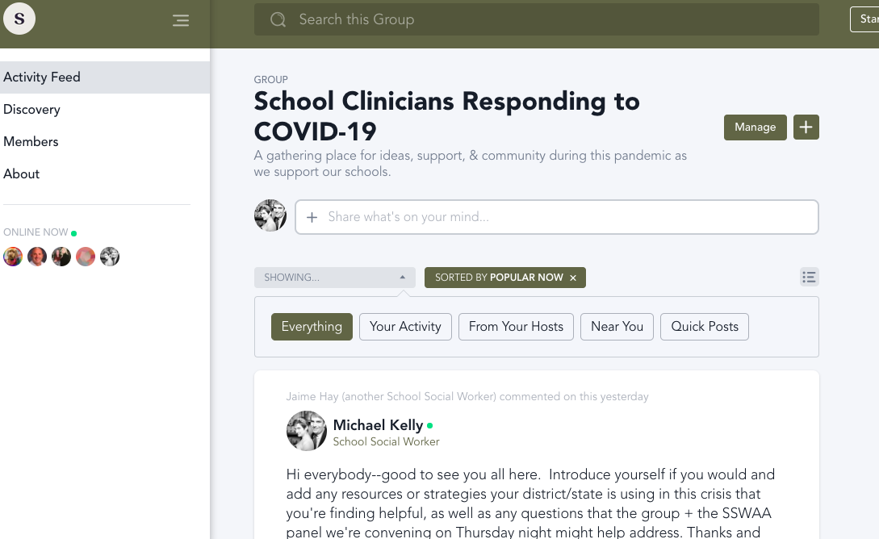
Resources to Support Your Practice
SSWNetwork (Free to join)

Slide 16
SSWRL
Evidence evaluated
Tags to guide personal organization
Anyone can submit resources, let’s do it!
ssw.resource.sharing@gmail.com
Notes:
Stephanie
SSWAA’s School Social Work Resource Library
Team of academics & practitioners evaluating submitted resources.
Tagging of resources helps you sort, search & save in your personal library (categories of high need like screening & assessment, prevention,intervention, & data-based decision-making)
Comments & ratings help you learn from the SSW experience of others
COVID-19 folder established in SSWRL & anyone can submit a resource.
We all do better when we all do better, so share what you find and what you use so we can support students and families and be our best.

Slide 17
SSWAA Supporting SSW’s
SSWAA Membership: https://www.sswaa.org/membership
Upcoming Webinars: https://www.sswaa.org/webinars
School Social Workers Promoting Social Justice and Racial Equity - March 31st at 11:00am-12:00pm Eastern
Going from Peer to Supervisor - April 23rd at 3:30-4:30pm Eastern
SSWAA National Conference: Powerful professional development event with up to 19.5 CEUs. Rescheduled for June 27-30, 2020 in Baltimore, MD. Registration will re-open April 6th. For more information: https://www.sswaa.org/nationalconference
SSW 2 SSW: School Social Worker to School Social Worker peer assistance groups are available to all SSWAA Full and Premiere members from now until June 1st! Great opportunity for professionals who want a safe space for sharing strategies, providing support, and assisting one another with ideas that may help the school social worker with practice issues. For more information and to register: https://www.sswaa.org/events

Slide 18
Questions
How are other School Social Workers are reaching out to students and parents (limited to internet or uneducated to access internet websites) during this time?
What are states deciding at this time regarding permitting School Social Workers to use Telehealth communication techniques (i.e., Google meet, Google #'s, Skype, FaceTime etc.)?
What are thoughts on recording SEL lessons or working on topics and sending via their Canvas or Google Classroom, documents they can work on?
If you are licensed by the state (LCSW or LSW) are there things you have to consider regarding your license and providing services via telehealth or phone?
If you did not get a consent signed to do telehealth or phone sessions, what can you do?

Slide 19



Slide 20
Certificate of Attendance
To receive a Certificate of Attendance please click on this link and fill out the form https://docs.google.com/forms/d/e/1FAIpQLSd1X7jp8mECIVSAxHZiP6nT_8LKlX-viGQ34mBBECWQMnoBxg/viewform
Thank you for attending and listening to this webinar! This is not a CEU certificate.

