Slide 1
School Social Work National Model
An Overview
Notes:
Developed from 2011-2013 by a group of school social work academics and practitioners. Designed to be flexible given the wide range of school social work delivery models.

Slide 2
Rationale
Purpose
Describes skills and services
Promotes consistency
Provides a framework for the evaluation of services
Guides advocacy efforts and service delivery decisions
Advantages
Improves academic and behavioral outcomes
Helps to ensure the delivery of scientifically supported services
Promotes a positive school climate and culture
Maximizes school-based and community resources
Notes:
The Model
* Describes the skills and services needed for the delivery of high quality social work services in schools * Promotes consistency to guide graduate education, credentialing, and professional practice * Provides a framework for the evaluation of services * Empowers those concerned about school social work services with a coherent model to guide advocacy efforts and service delivery decisions * Recommends a general ratio of 1:250 students depending on the characteristics and needs of the student population served. Students with intensive needs would require a lower ratio * Is to be used in conjunction with NASW’s Standards for School Social Work Practice and Code of Ethics, as well as SSWAA’s Ethical Guidelines Series. * Includes a School Social Work Practice Model Brochure, School Social Work Practice Model PowerPoint (pending), and an evaluation handout (pending).
Advantages of Adopting the Model
* Improve academic and behavioral outcomes * Help to ensure delivery of scientifically supported education, behavior, and mental health services * Promote a school climate and culture conducive to student learning and teaching excellence * Maximize school-based and community resources
School Social Workers
* Are trained mental health professionals * Have a degree in social work * Provide services related to a person’s social, emotional, and life adjustment to school and society * Are the link between home, school, and community in providing services to students, families, and school personnel * Promote and support students’ academic and social success

Slide 3
Notes:
The roles and responsibilities of school social workers vary significantly across schools, districts, states, and countries.
The purpose of the School Social Work Practice Model is
(1) to articulate the skills and services that can be expected from school social workers, and
(2) to promote consistency in undergraduate and graduate social work education, credentialing, and professional practice, with the goal of improving academic and behavioral outcomes.
Overview
The Practice Model encourages school social workers to simultaneously 1) provide evidence-based educational, behavioral, and mental health services; 2) promote school climate and culture conducive to learning; and 3) maximize access to school-based and community-based resources. School social workers are expected to possess advanced knowledge and technical skills to guide their practice in these three areas.
There are a variety of factors that influence the percentage of time school social workers allocate to these different roles. The most obvious factor is the ratio of Full Time Equivalence to the number of students served. For all of the practices and key constructs in this model to be implemented effectively, a full-time social worker is required, which is approximately a 1-250 school social worker-student ratio. This estimate will vary depending on several factors, such as the percentage of high-risk students, the experience and expertise of the school social worker, and the availability of other services in the school and the community. Other factors that may affect the job description of school social workers are the priorities and expectations of the school/district.
Each of the practice features is supported by historical school social work scholarship and research that serve to delineate this specialized form of professional social work practice. The following key constructs are infused into each practice features: 1) Home-school-community linkages, 2) Ethical guidelines and educational policy, 3) Education rights and advocacy, and 4) Data-based decision-making

Slide 5
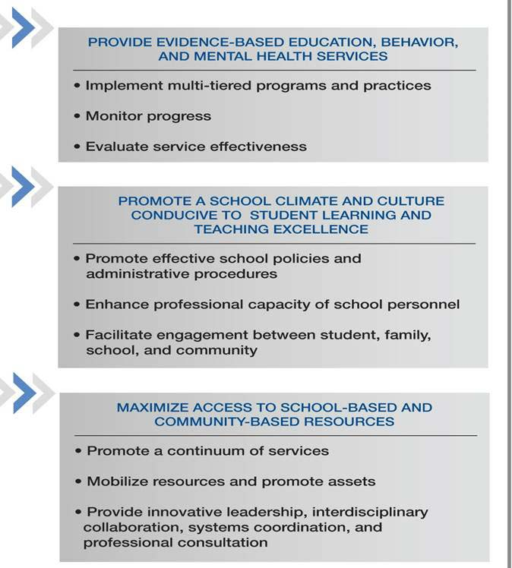

Slide 6
Practice #1: Provide evidence-based education, behavior, and mental health services
Primary direct service component
Unique expertise in child and family work
Assistance to school staff in implementing interventions with fidelity
Accomplished by…
Implementing multi-tiered programs and practices,
Monitoring progress, and
Evaluating effectiveness
Notes:
Providing evidence-based education, behavior, and mental health services to support academic and behavior outcomes constitutes the primary direct service component of school social work practice. School social workers have expertise in child and family work that is unique because it also incorporates school and community stressors that interfere with educational success. In addition, school social workers’ consultative skills can assist other school staff in implementing interventions with fidelity. This practice feature is accomplished by:
Implementing multi-tiered programs and practices,
Monitoring progress, and
Evaluating effectiveness
School social workers are expected to possess advanced knowledge and technical skills to guide their practice in these three areas.
The proportion of their time that school social workers engage in each practice varies widely depending on contextual factors, including the needs of the community, school, families, and students served.

Slide 7
Practice # 2: Promote a school climate and culture conducive to student learning and teaching excellence
School policies and procedures
Capacity-building
Supportive relationships
Accomplished by…
School policies and administrative procedures
Enhancing professional capacity
Facilitating engagement
Notes:
Promoting school climate and culture conducive to learning refers to the psycho-social environment that fosters academic engagement and achievement. Schools with contexts conducive to learning have: 1) policies and procedures that produce safe and orderly environments; 2) capacity-building efforts to promote effective practices; and 3) supportive relationships within and between students, families, school staff, and community partners. Implementing this practice feature is accomplished by:
Promoting effective school policies and administrative procedures
Enhancing professional capacity of school personnel
Facilitating engagement between student, family, school, and community

Slide 8
Practice #3: Maximize access to school-based and community-based resources
Primary indirect or macro-practice component
Coordinates available services
Capitalizes on knowledge of school and community resources
Accomplished by…
Promoting a continuum of services
Mobilizing resources and promoting assets
Providing innovative leadership, interdisciplinary collaboration, systems coordination, and professional consultation
Notes:
Maximizing school-based and community-based resources constitutes the primary indirect or macro-practice component of school social work services. This involves coordinating available services within the school or reaching out to community partners to secure services to meet school needs. School social workers have extensive knowledge about school system services as well as the scope of services available within the community, and they possess the skills to navigate these service delivery systems (e.g., health, mental health, child welfare, and juvenile justice). As a part of their role in the school system, school social workers challenge barriers to accessing school-based and community-based resources that support academic and behavioral success. This practice feature is accomplished by:
Promoting a continuum of services
Mobilizing resources and promoting assets
Providing innovative leadership, interdisciplinary collaboration, systems coordination, and professional consultation.

Slide 9
Key Constructs
Home-school-community linkages
Ethical guidelines and educational policy
Education rights and advocacy
Data-based decision-making
Notes:
Each school social work practice is supported by historical scholarship and research that delineates this specialized form of professional social work practice.
The following key constructs are infused into each practice.
Home-school-community linkages
Academic achievement and behavior are profoundly impacted by the environment, including relationships and interactions across home, school, and community settings. Facilitating communication and promoting linkages across these systems is a central characteristic of school social work practice.
Ethical guidelines and educational policy
School social workers follow professional ethical guidelines and carry out federal and state educational policy to provide the highest level of school social work practice. The National Association of Social Workers (NASW) Code of Ethics and School Social Work Association of America (SSWAA) Ethical Guideline Series define expectations for ethical school social work practice.
School social work literature further facilitates accountability by promoting the use of an ethical decision-making model when applying laws, policies, and codes to specific school dilemmas. The Code of Ethics emphasizes the need for continuous professional development to keep abreast of evidenced-based practices in the field, and reflection on evidence-based practices to ensure that they fit the context and culture of the school setting.
Education rights and advocacy
School social workers address the ways in which structural inequalities and school processes affect school quality and educational outcomes. School social work practitioners are expected to raise issues of diversity and social and economic justice that lead to school failure and educational disparities.
School social workers should be able to balance their mandate as school employees to advocate for students and families with their mandate as social workers to help change policies and practices that undermine the dignity and worth of students.
Data-based decision-making
School social workers use the best current research to design and implement interventions. School social work services should be informed by the research literature, adapt empirically supported interventions to fit student needs, and routinely evaluate the effectiveness of policies, programs, and practices.

Slide 10
National Evaluation Model of School Social Work Practice
Based on Teacher Evaluation Frameworks
Includes 4 domains
Planning and Preparation
Context for Learning
Service Delivery and Resources
Professional Responsibilities
Performance Expectations
Notes:
The Danielson Framework for Teaching: School Social Work is cross-walked with the National Association of Social Workers Standards for School Social Work Services (2012) retrieved at http://www.naswdc.org/practice/standards/NASWSchoolSocialWorkStandards.pdf and with the School Social Work Association of America’s School Social Work Practice Model (2013) retrieved at http://sswaa.org/displaycommon.cfm?an=1&subarticlenbr=459
Also DC Public Schools and Hillboro, FL school district

Slide 11
Supplemental Documents
NASW’s Standards for School Social Work Practice
NASW’s Code of Ethics
SSWAA’s Ethical Guideline Series
School Social Work Practice Model Brochure
Teacher Evaluation Frameworks

Slide 12
Thank you!
Correspondence concerning the model should be addressed to: ContactUs@sswaa.org
Citation:
Frey, A.J., Alvarez, M.E., Dupper, D.R., Sabatino, C.A., Lindsey, B.C., Raines, J.C., Streeck, F., McInerney, A., Norris, M.A. (2013). School Social Work Practice Model. School Social Work Association of America. Retrieved from http://sswaa.org/displaycommon.cfm?an=1&subarticlenbr=459

